Slide 1

Nasa Datasets
Victor Barboza Morais

Slide 2

Bearings Dataset
3 tests
4 bearings each
Sampling
1 second every 10 minutes (one exception)
20kHz, 20480 rows

Slide 3
Bearings Dataset
Stop criteria
Failure of at least one bearing

Slide 4
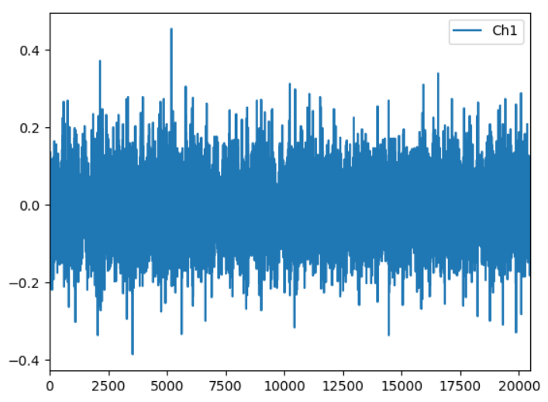
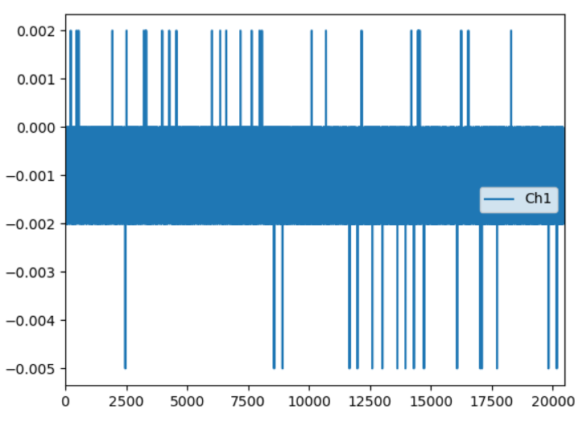
Bearings Dataset
Bearing of failure. At the left is at the very beginning of the experiment and at the right is the last sample collected

Slide 5
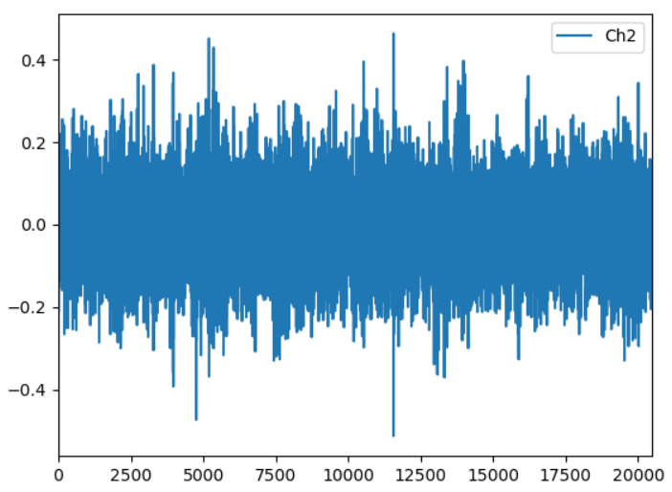
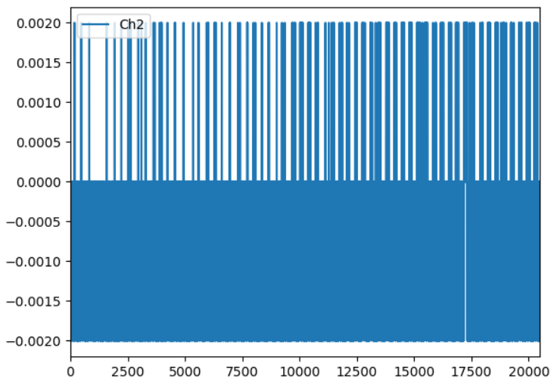
Bearings Dataset
Bearing for comparison. At the left is at the very beginning of the experiment and at the right is the last sample collected

Slide 6
Batteries Dataset
6 datasets
Different room temperatures (24C or 4C)
3 or 4 batteries for each experiment
Experiments run until 30% fade in capacity
At least 56 batteries were used in total

Slide 7
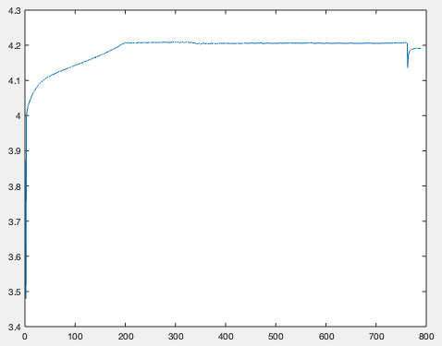
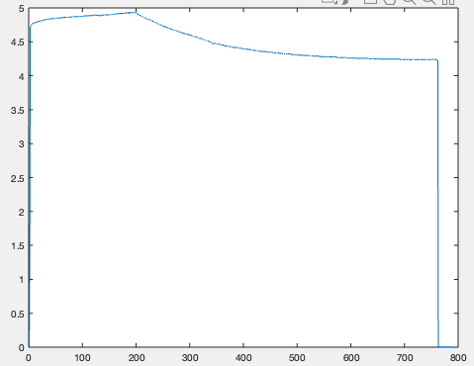
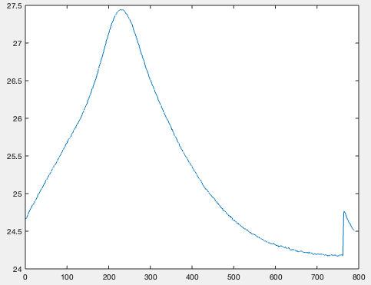
Batteries Dataset (charging)
From left to right: Measured voltage, charged voltage and measured temperature

Slide 8
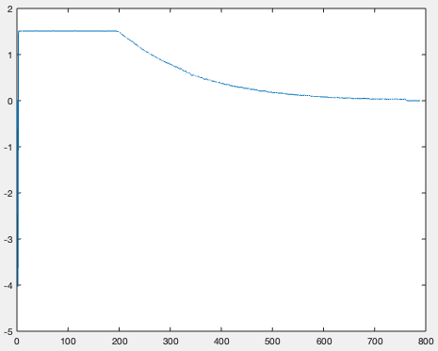
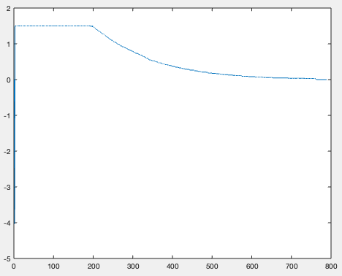
Batteries Dataset (charging)
From left to right: Measured current and charged current

Slide 9
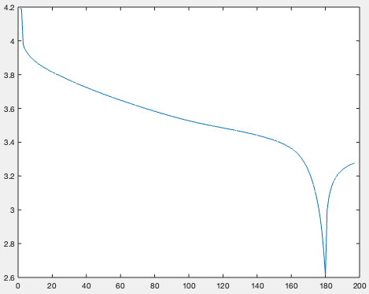
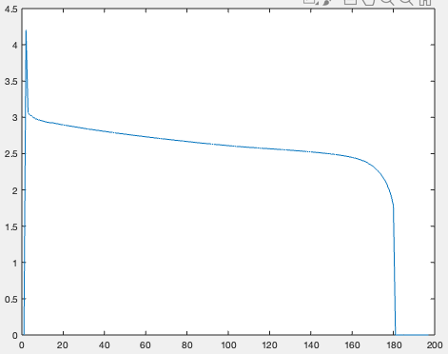
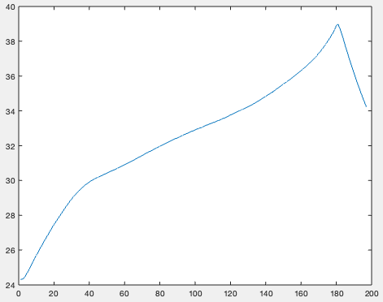
Batteries Dataset (discharging)
From left to right: Measured current and charged current
From left to right: Measured voltage, voltage load and measured temperature

Slide 10
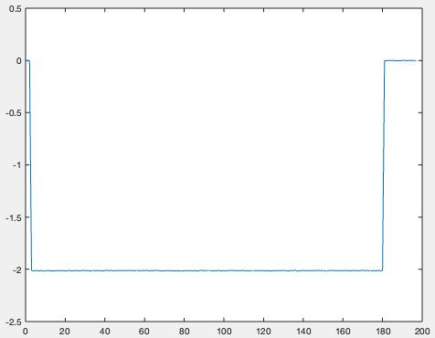
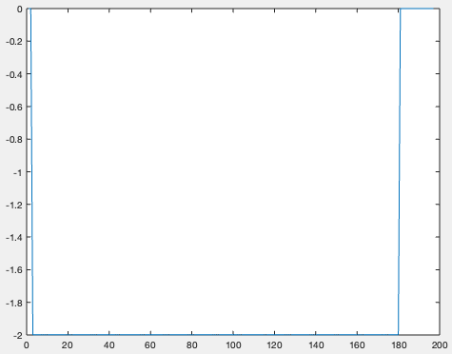
Batteries Dataset (discharging)
From left to right: Measured current and charged current

Slide 11
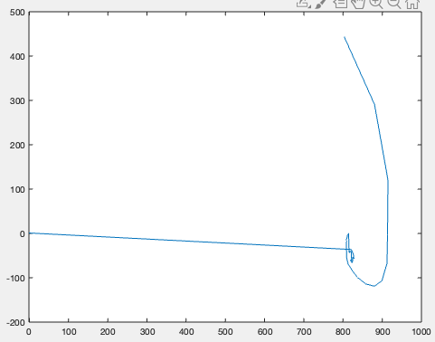
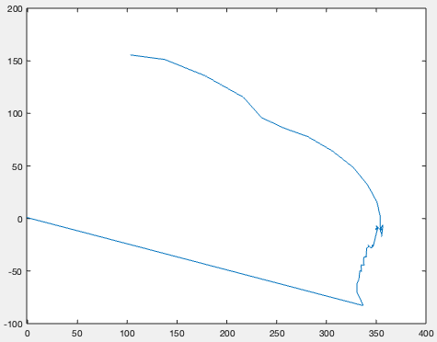
Batteries Dataset (impedance)
From left to right: Sense current and battery current

Slide 12
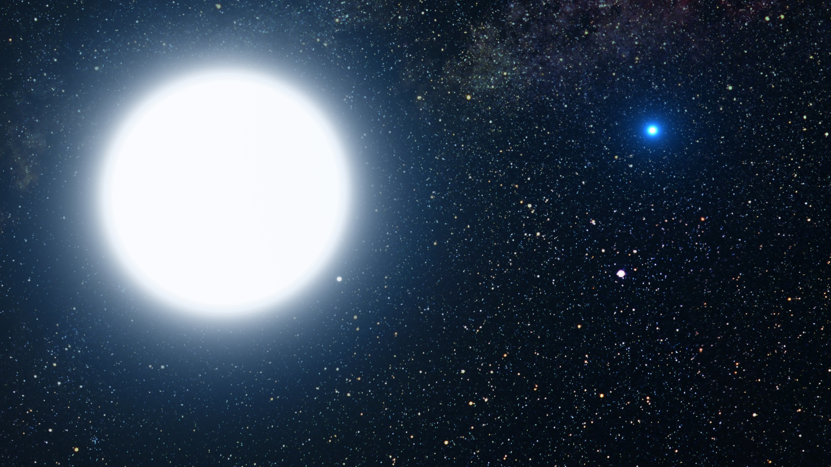
References
http://data-acoustics.com/measurements/bearing-
faults/bearing-4/
https://ti.arc.nasa.gov/tech/dash/groups/pcoe/prognostic-data-repository/#battery
https://pixabay.com/pt/illustrations/bin%C3%
A1ria-c%C3%B3digo-mulher-face-vista-1327492/
https://pixabay.com/pt/photos/star-sun-an%C3%A3-branca-sistema-estelar-67705/
https://pixabay.com/pt/illustrations/rastreamento-de-pulso-163708/

